Slide 1
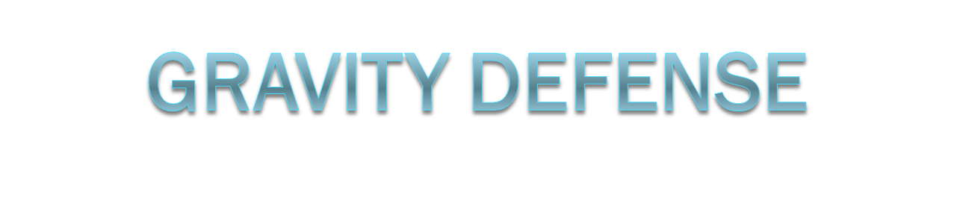
Team : Asterokids
Nole Pierre
Bertin Matthieu
Castellani Gianni
Petitfils Quentin

Slide 2
High Concept
Gravity Defense is a tower defense game in the space. The purpose is to protect the sun attacked by asteroids. The player has to create and upgrade planets to attract, repulse or destroy asteroids.

Slide 3
Level Design
Standard level :
  vision on the whole solar system
  Points in common:
    In the space;
    Some elements : the sun, the planets and the asteroids.
  Different points:
    The number and the place of orbits;
    The life and the gravity of the Sun.

Slide 4
Gameplay
To win : the sun must survive a sequence of rounds.
A round is composed of two phases:
  the tactic phase:
    Planets : place, move, remove and upgrade
    Directions of next wave’s asteroids
  The defense phase :
    when the asteroids actually come to destroy the sun.
The game becomes harder as the player progress through rounds. There is more and more asteroids each round, becoming bigger, thus being harder to destroy and being less influenced by gravity.
Placing or upgrading planets costs money. At the end of each wave the player is given a certain amount of money, allowing him to afford a few planets or upgrades. Every time an asteroid is destroyed, the player also receives a small amount of money.

Slide 5
Controls
The game is entirely playable with a mouse:
During the tactic phases:
  left click
    on a planet to show the available upgrades
    on the upgrade buttons to upgrade the planet
    on the sun to show its life
    to drag and drop a planet on its orbit
    on an orbit to create a planet

Slide 6
Target
The game will appeal to player who loved tower defense game and reaching a new gameplay.

Slide 7
Why to invest in Gravity Defense?
Quick to develop
Unique gameplay
Casual game

